Slide 1
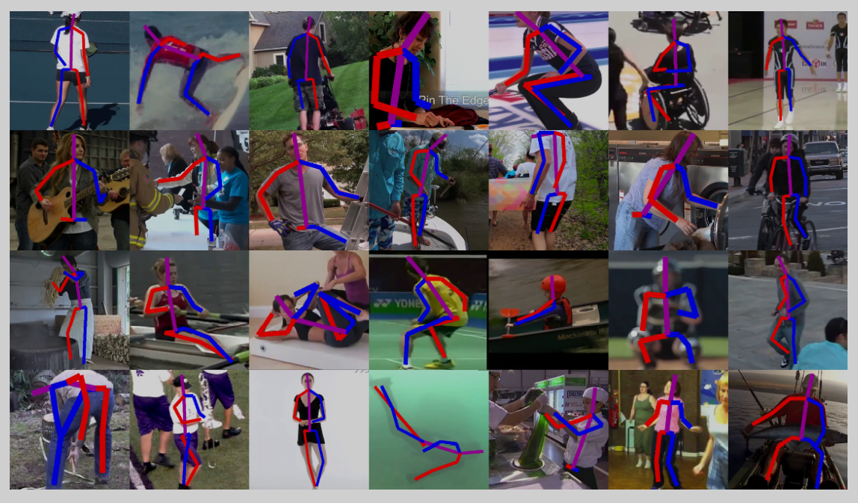
Incremental Learning for Human Pose Estimation
Kardelen Ceren
Bachelor’s Semester Project
Supervisor: Megh Shukla
CS-398, 8 credits

Slide 2

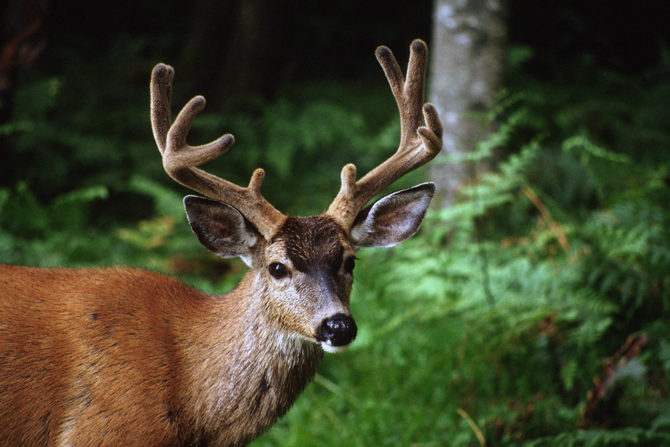




Incremental (Continual) Learning
Model 0
Model 1
Model 2
New dataset
New dataset
Goal: Maintaining performance on the old task, while learning the new task

Slide 3
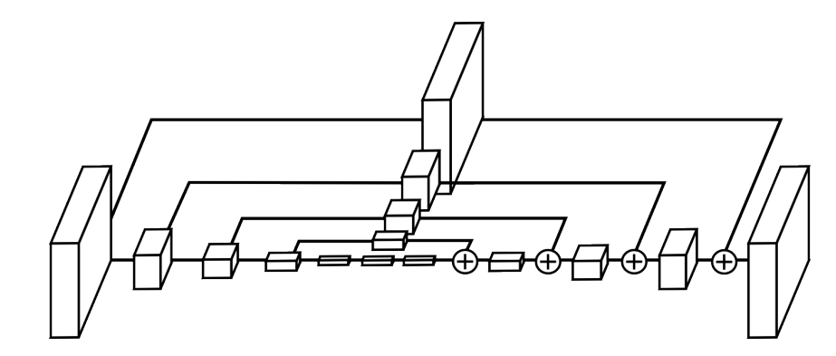
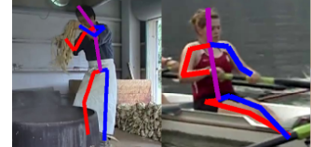
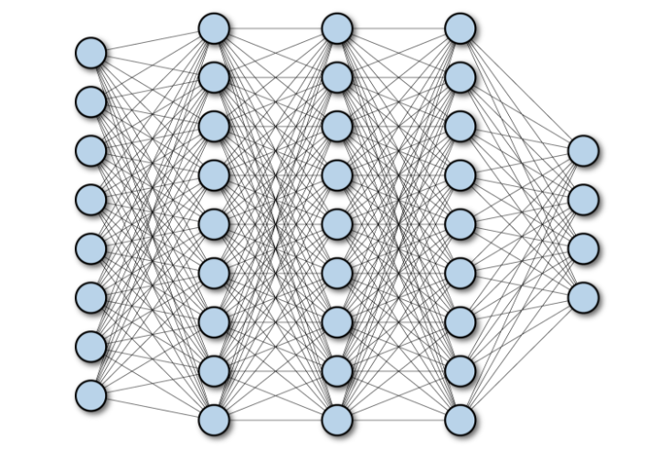
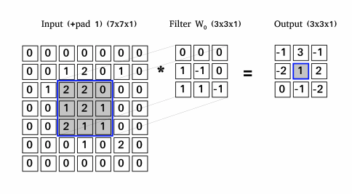
Incremental Human Pose Challenges
Human pose predictions [2]
Hourglass Structure from the Stacked Hourglass Network [2]
Fully connected layers vs. CNN kernels (filters)
[1] Newell, Alejandro, et al. “Stacked Hourglass Networks for Human Pose Estimation.” ECCV 2016, https://doi.org/10.1007/978-3-319-46484-8_29.

Slide 4
Problem Statement
Testing incremental learning methods on the task of human pose estimation.
Input: Human pose datasets
Output: Model that can learn incrementally

Slide 5
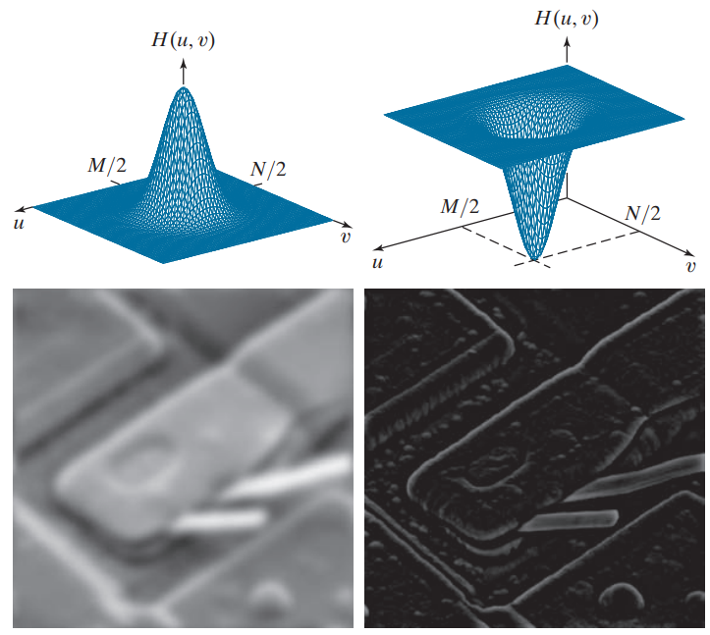
Final Method
Pre-train Stacked Hourglass with MPII
Train incrementally with LSP, using:
Naïve finetuning
Regularization
with L2 norm of all parameters
with the Fourier responses of CNN filters
Results of different frequency filters [2]
[2] Gonzalez, Rafael C., and Richard Eugene Woods. Digital Image Processing. Pearson, 2018.

Slide 6
Results
Model | Test Dataset | Average | Assessment
Base Model | MPII | 0.808 | Cannot predict the new dataset
Base Model | LSP | 0.104
Finetune | MPII | 0.655 | Forgets to some degree Does not learn well
Finetune | LSP | 0.682
Regularization | MPII | 0.592 | Forgets to some degree Learns well
Regularization | LSP | 0.789
Fourier Regularization | MPII | 0.479 | Forgets Learns well
Fourier Regularization | LSP | 0.805
Results of different incremental learning experiments in PCKh@0.53,
(Percentage of Correct Keypoints with threshold)

Slide 7
Thank you for your attention

